Slide 1

Final Project
Description of the steps needed to design your pipeline

Slide 2
Design your pipeline
Technical outline
Setups in Snowflake

Slide 3
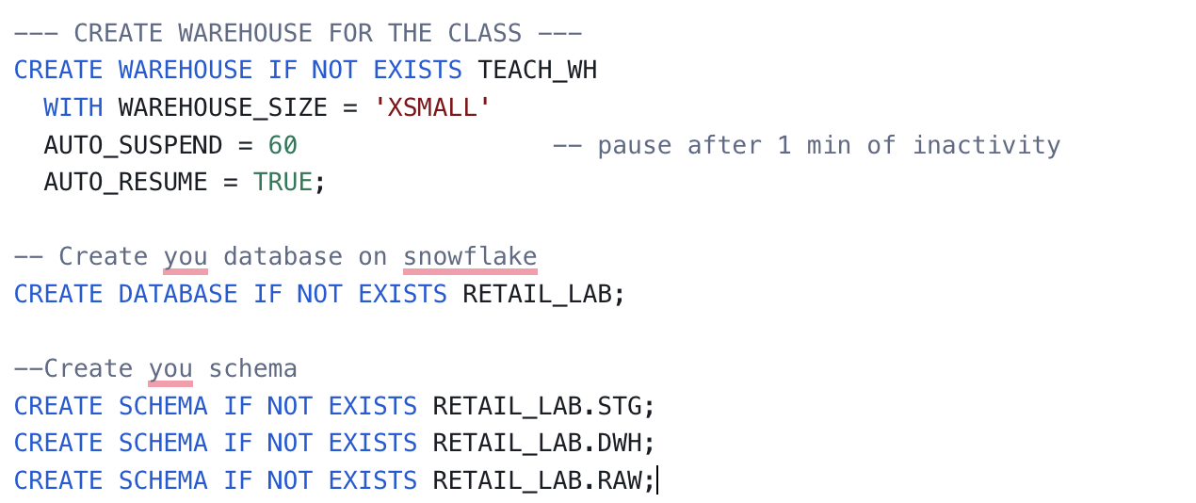
STEP 1: Create your raw data
Python
Use the generator to generate data : customers, orders, product
(Optional upload the data to an SQL database)
Extract : Connect to the SQL database to retrieve your data
Connect to Snowflake
Upload the data to Snowflake
Snowflake
Create a warehouse
Create a Database
Create three schema : prod, staging, raw
Create your destination table

Slide 4
Technical STEP 2 : Create your event
Python
Setup your docker with redpanda, your producer and your consumer
Write the code to produce event messages
Write the code to consume messages and send them to snowflake
Snowflake
Create your event table

Slide 5
PROJECT STEP 3 : Automate the update of your table
Python
Send new events to snowflake
Snowflake
Create a stream on your events table
Create and schedule your update task

Slide 6
PROJECT STEP 4 : Step Monitoring
Snowflake
Select what entity you want to monitor
Create your analytics tables
Call those tables in an App Streamlit

Slide 7
What is expected
A full repo with all your project scripts.
A schema to outline the steps of your process.
Your snowflake SQL scripts that you can share via a link : the automation scripts with stream and task and validation scripts to check if your data was well processed.
Screenshots of your snowflake tables to validate that you ingested the data.
A video of the data streaming with kafka (events created, and their ingestion in Snowflake).
Or a video of automation process in snowflake.
A screenshot/a video of your monitoring APP.

